Slide 1
Codenvy v4.7
Local IDE integration
By Andrey Solodov
Skype: andrey.solodov_1
Email: andrey.solodov@aurea.com

Slide 2
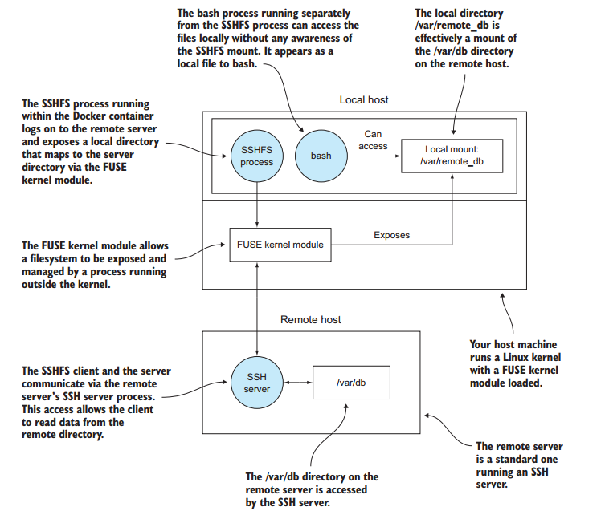
Theory
In Codenvy the project’s sources are stored in workspace Docker container /projects folder.
This folder is a folder on Codenvy bind mounted to a point /projects inside workspace Docker container. Basically it’s a Docker volume.
We can create ssh connection from local machine to Codenvy workspace container and mount /projects folder to our local folder. After that we can work with the code in preferred IDE (Eclipse, IDEA, NetBeans, etc.) and every change we will make will be synced with Codenvy. For that purpose we will use SSHFS. Very important thing to remember is that the sources will not be copied on your local machine as this is just a mounted folder. So, after you break ssfs connection the folder will disappear. BUT all the changes will be saved in Codenvy and next time you create the sshfs connection you will see them locally again.

Slide 3
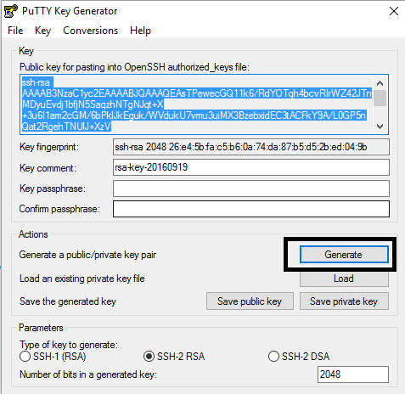
Prerequesites. Windows.
All the following steps are need to be done only once. First you need to install Sftp Net Drive Free.https://www.eldos.com/files/sftpnetdrive3/SftpNetDriveFree.exe
After you install it you need to generate SSH key pair. You can use Putty KeyGen for that.

Slide 4
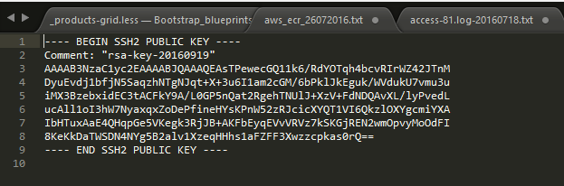
Prerequesites. Windows.
Save public and private keys. Private key you need to store locally. The public key should be uploaded to Codenvy, BUT first you should edit it. This is how it looks like after generation:
We need to make it one line, starting with ssh-rsa
Please notice that after ssh-rsa the whitespace is required.

Slide 5
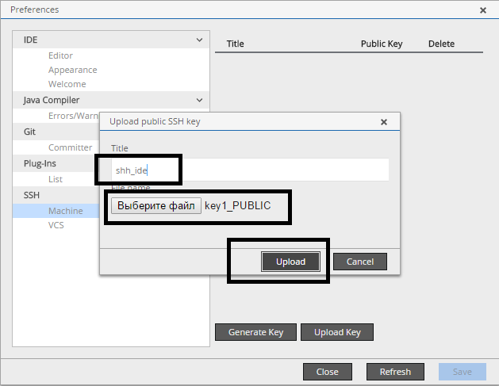
Public key upload
Next we need to upload public key to Codenvy. Please go to Profile > Preferences > SSH > Machine. IMPORTANT! After that restart the workspace.This key will be added to ~/.ssh/authorized_keys when your workspace starts.

Slide 6
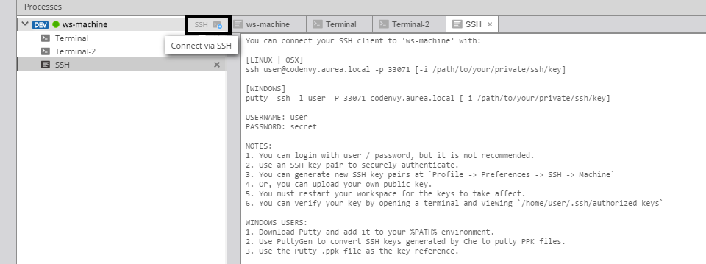
Connection details
Now we need to get connection details. Please push SSH button (if there is no SSH button please refresh the page) and remember the port number (on the screen 33071, but you will have a different one)

Slide 7
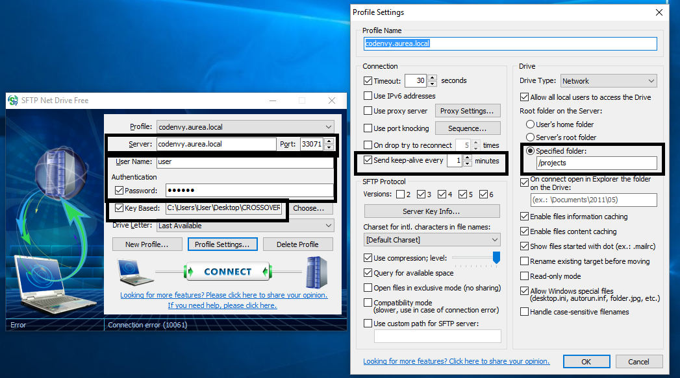
SFTP Net drive settings
Then we need to provide SFTP Net Drive with the settings: host, port, user (user), password (secret), private key location, folder to mount. And press Connection button.

Slide 8
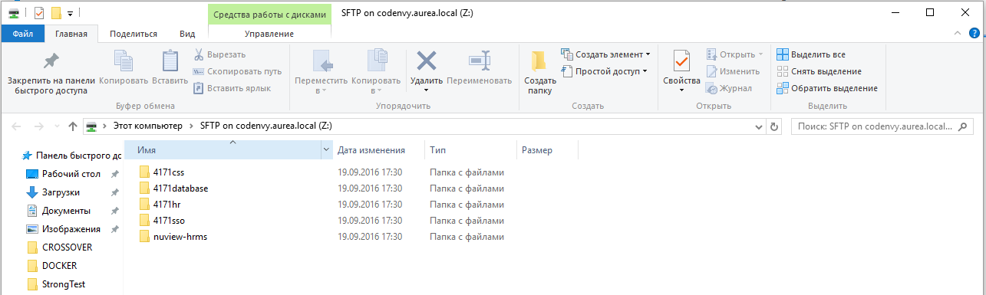
New Drive
After that the new drive is mounted with the sources code from Codenvy.You can work on it in your local IDE

Slide 9
Linux, MacOS
For UNIX-like operating systems the steps are basically the same. You need to generate keys with ssh-keygen -t rsa command, upload a public key to Codenvy (first please check its format) and then execute the sshfs command. Like this one:
sshfs user@codenvy.aurea.local:/projects /your/local/directory/ -p 33071
Please bare in mind that this part should never be changed sshfs user@codenvy.aurea.local:/projects
This is where you want to mount the sources locally /your/local/directory/ (for example ~/projects/HRMS)
And the port is unique every workspace start/stop cycle -p 33071
You can check this link for detailed instructions:
http://codenvy.readme.io/v4.4/docs/using-desktop-ides

